Slide 1
Med-Analytica@ a trusted AI partner
Technical Overview of Architecture
Nilothpal Bhattacharya, M.Tech Intelligent Systems

Slide 2
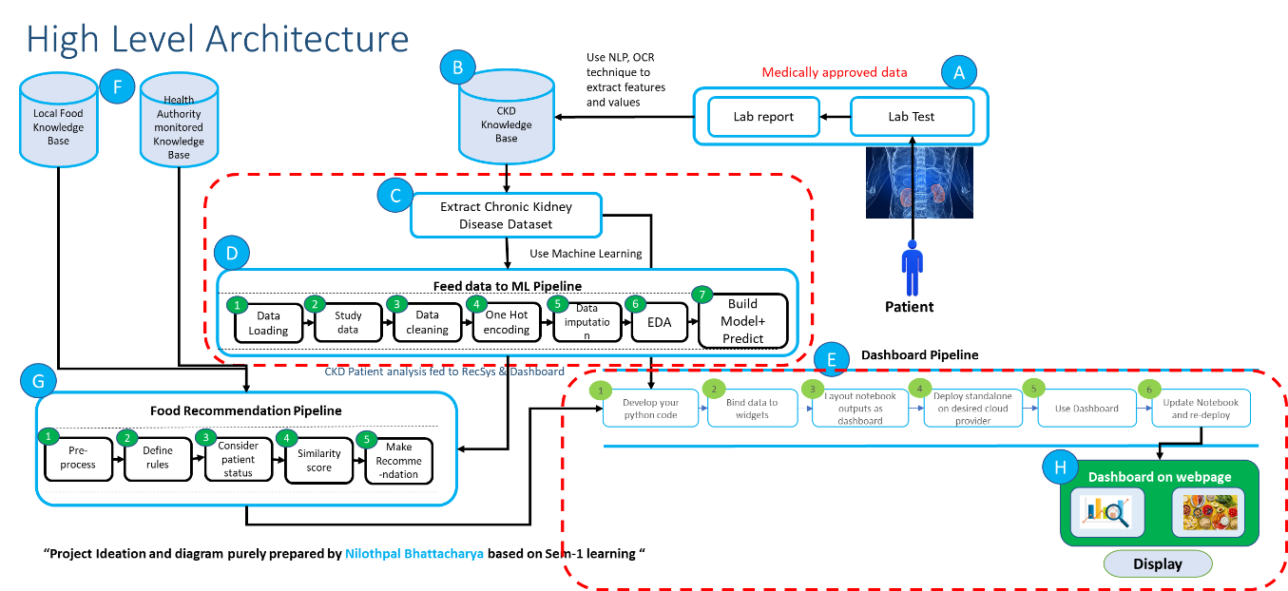
High Level Architecture – Med Analytica
Nilothpal Bhattacharya, M.Tech Intelligent Systems

Slide 3
Deployment design - – Med Analytica
New Data without classification label
Python based FLASK App
CKD Data
- model_build_train.py
Logistic_regression_model.pkl
Web App for Classification
- ckd.py
Templates
- All html pages
Output : CKD or NotCKD
Python based Streamlit App
For Dashboarding and Analysis
StreamLit Web App
Nilothpal Bhattacharya, M.Tech Intelligent Systems

Slide 4
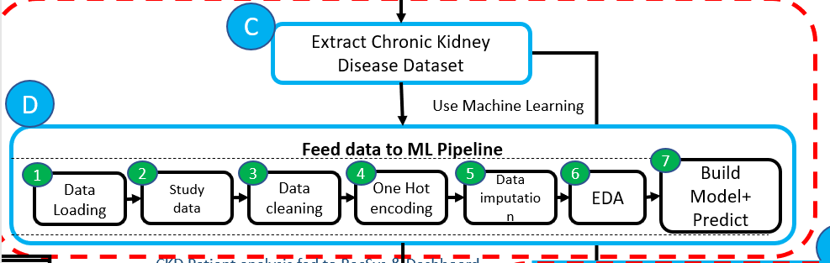
Model building Pipeline

Slide 5
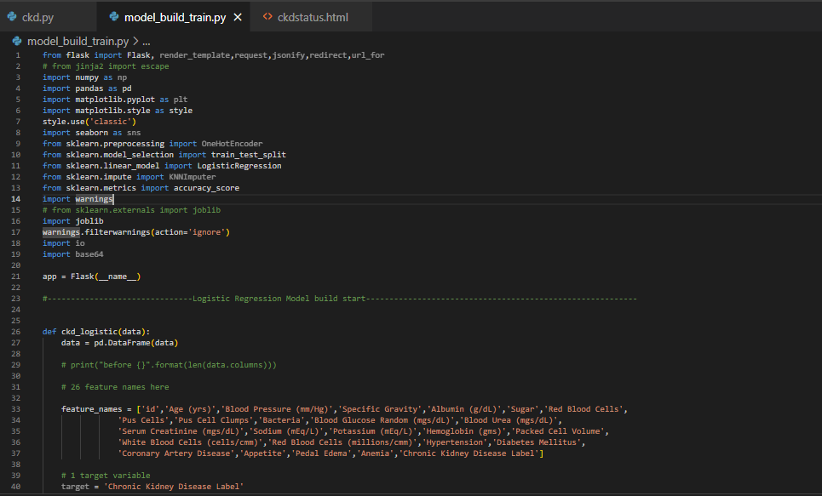
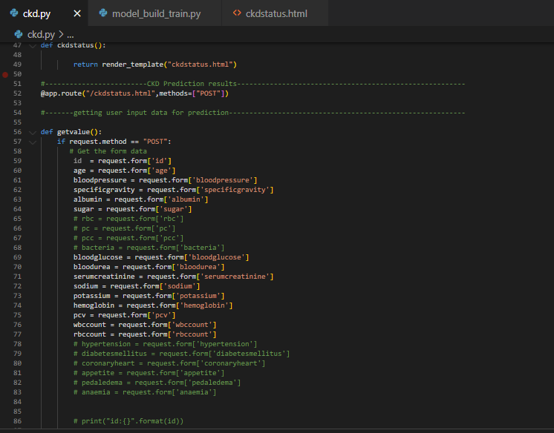
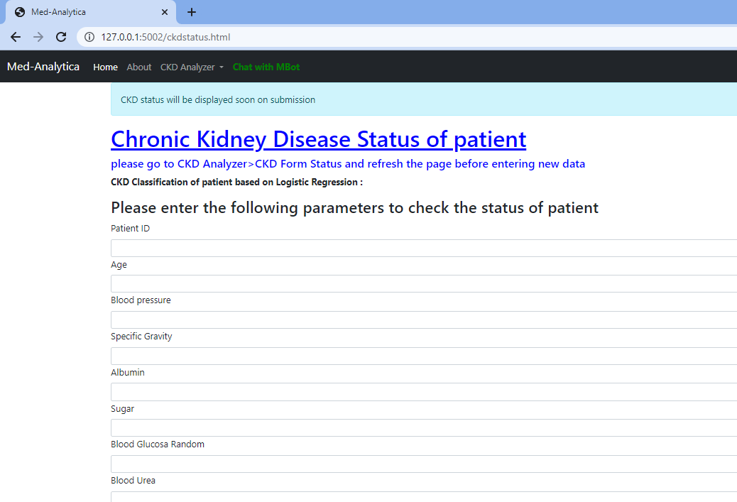
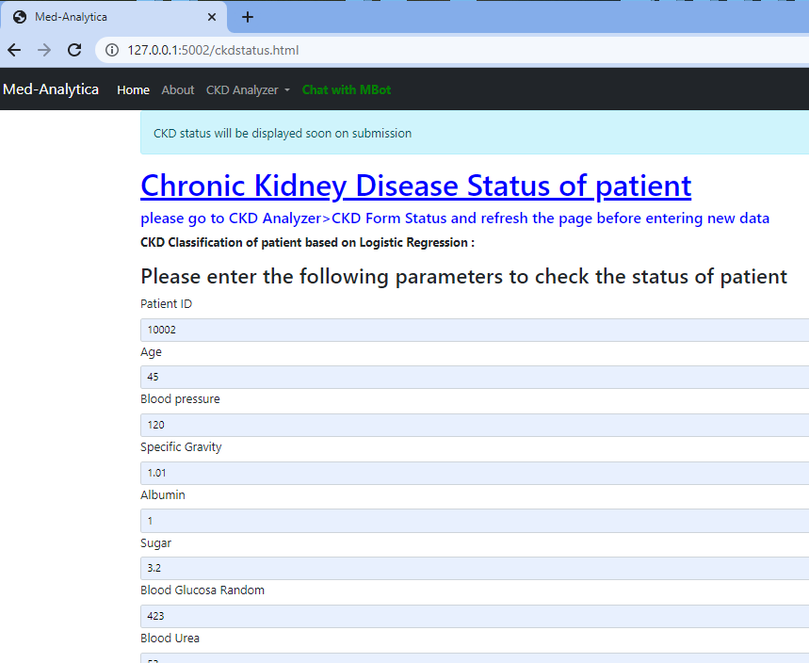
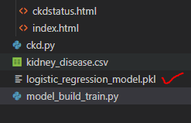
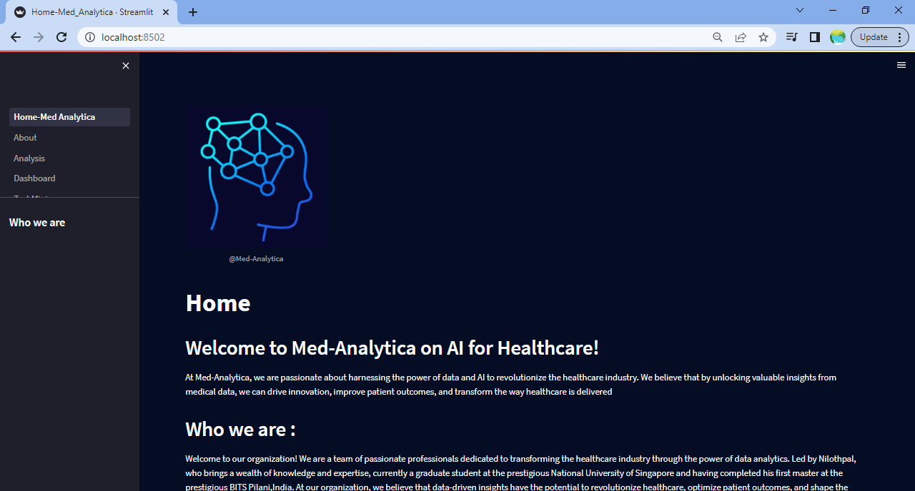
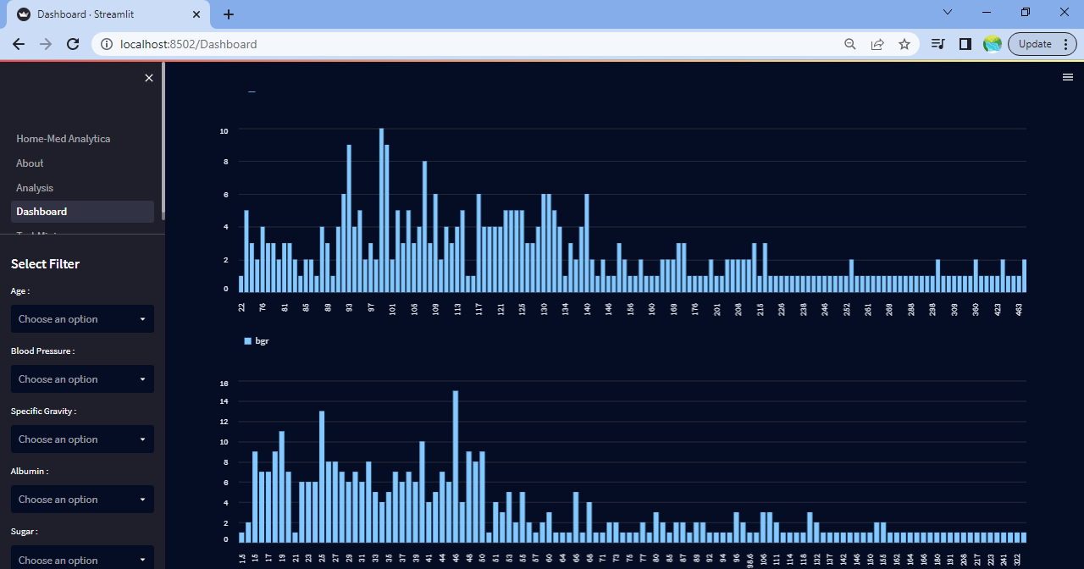
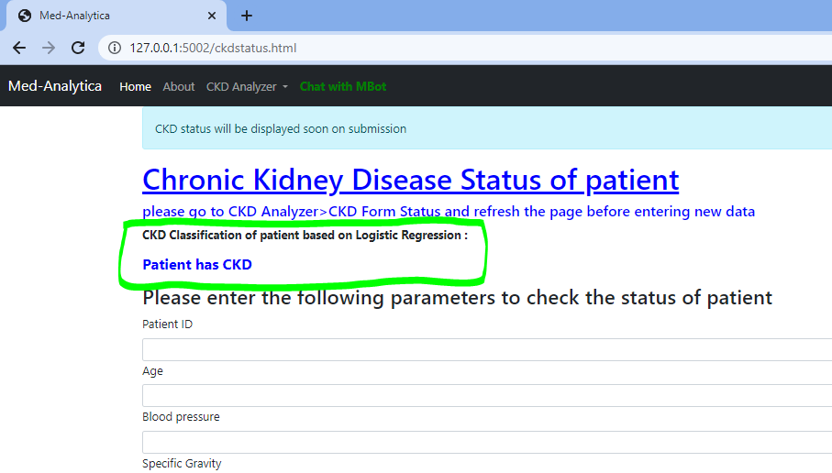
Model built and trained
Web Classification app running on local host with blank form
4
5
1
2
http://127.0.0.1:5002/ckdstatus.html
CKD Data
6
3
Main Flask App to be executed to start hosting web app
Doctor/Nurse enter patient details to predict
Model generated
8
9
7
CKD /NotCKD classification O/P predicted

Slide 6
Thank you ☺

